Slide 1


NEON
RUNNER
Proyek Calon Asisten Lab Jaringan - Nelson Laurensius

Slide 2

What is Neon Runner?
Neon Runner adalah game endless runner bertema cyberpunk yang menggabungkan gameplay klasik dengan fitur modern seperti leaderboard online, power-up, shop, dan sistem akun.
Dibangun dengan stack modern: React (frontend), Spring Boot (backend), dan MySQL (database).

Slide 3
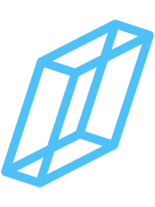

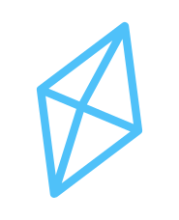

Fitur Utama
Endless runner dengan kontrol jump/duck
Responsive UI (mobile & desktop, portrait & landscape)
Leaderboard online global
Power-up (Double Coin, Double XP, Shield)
Shop untuk pembelian power-up
Sound & music in-game
Sistem akun (register, login, progres tersimpan)
Overlay pause, game over, shop, leaderboard yang konsisten

Slide 4




Framework & Library yang Digunakan
Frontend:
React
TypeScript
TailwindCSS
Vite
Howler.js (audio)
Lucide React Icons

Slide 5




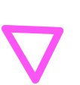
Framework & Library yang Digunakan
Backend:
Spring Boot (Java)
Spring Security (JWT Auth)
REST API
Database:
MySQL

Slide 6






PROBLEM
Venus has a beautiful name and is the second planet from the Sun. It’s terribly hot—even hotter than Mercury

Slide 7

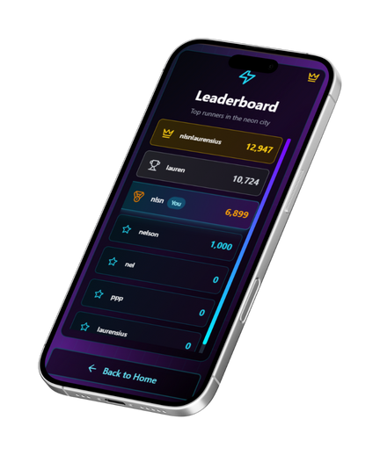
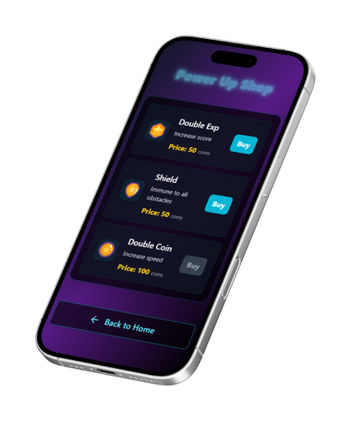

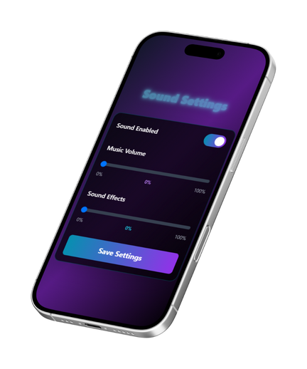
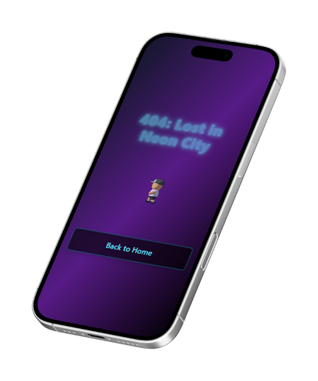

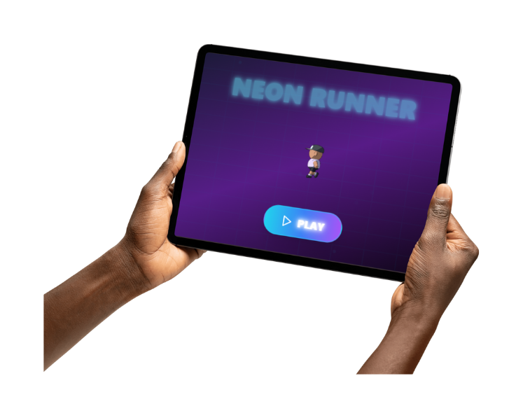
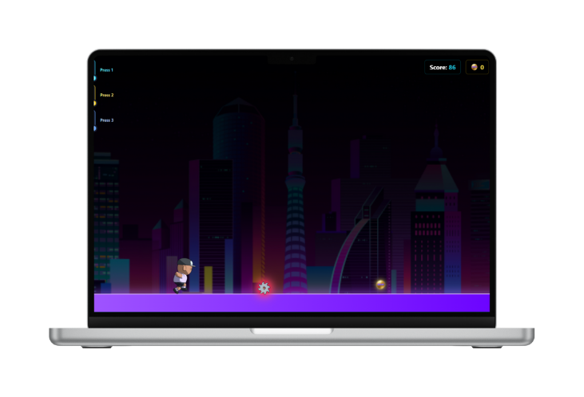
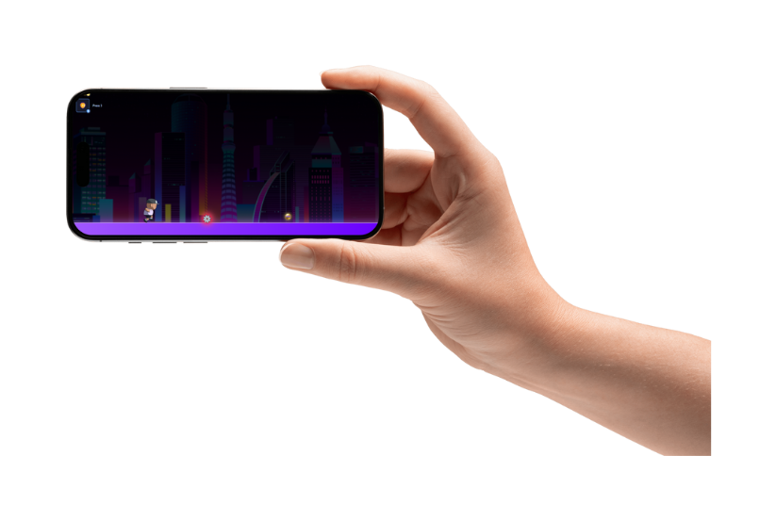


Slide 8

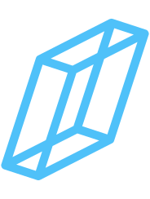
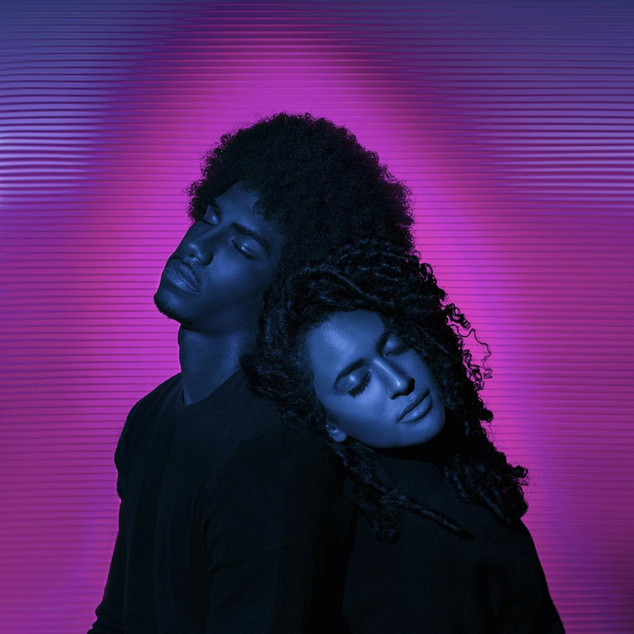
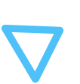

OUR TEAM
AWESOME ANDY
BRILLIANT BIRDIE
Here you could talk a bit about this person
Here you could talk a bit about this person

Slide 9



SOLUTION
Mercury is the closest planet to the Sun and the smallest one in the Solar System—it’s only a bit larger than the Moon

Slide 10




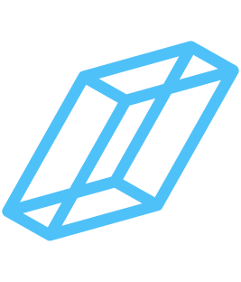
THEM VS. US
THEM
US
Mercury is the closest planet to the Sun and it’s also the smallest one in the Solar System
Venus has a beautiful name and is the second planet from the Sun. It’s hotter than Mercury

Slide 11
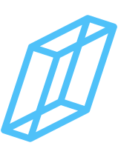


KEY DIFFERENCES
MERCURY
VENUS
MARS
Mercury is the closest planet to the Sun
Venus is the second planet from the Sun
Despite being red, Mars is a cold place
JUPITER
SATURN
NEPTUNE
It’s the biggest planet in the Solar System
Saturn is the ringed one and a gas giant
Neptune is the farthest planet

Slide 12
SWOT
S
W
O
T
Despite being red, Mars is actually cold
Mercury is the closest planet to the Sun
Venus has a beautiful name, but it’s hot
Jupiter is the biggest planet of them all

Slide 13

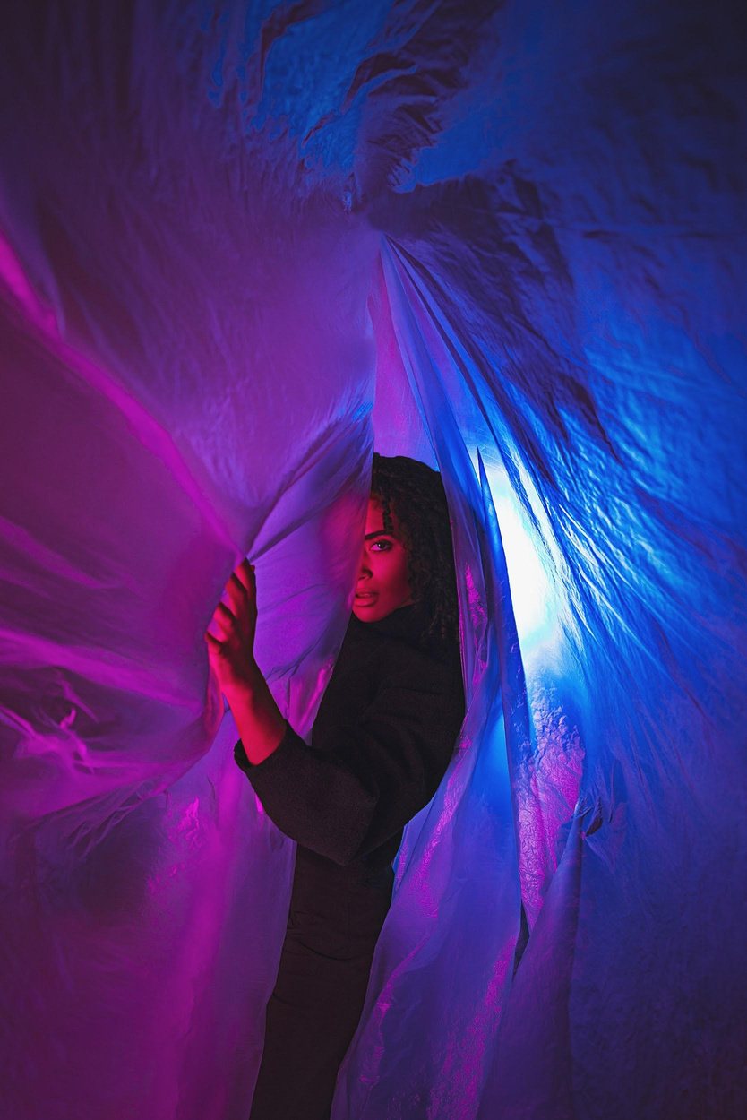
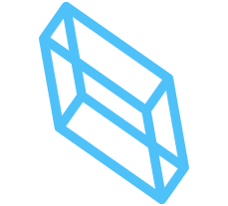
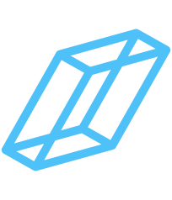
Mercury is the closest planet to the Sun and the smallest one in the Solar System
PRODUCT OVERVIEW
Venus is the second planet from the Sun. It’s terribly hot, even hotter than Mercury

Slide 14

OUR PLANS
BASIC
PRO
PREMIUM
$19.99
$25.99
$30.99
Mercury is the smallest closest planet to the Sun
Despite being red, it’s actually a really cold place
Jupiter is the biggest planet in the Solar System

Slide 15

HERE IS A TABLE
 | MASS | DIAMETER | GRAVITY
MERCURY | 0.06 | 0.38 | 0.38
MARS | 0.11 | 0.53 | 0.38
SATURN | 95.2 | 9.4 | 1.16

Slide 16
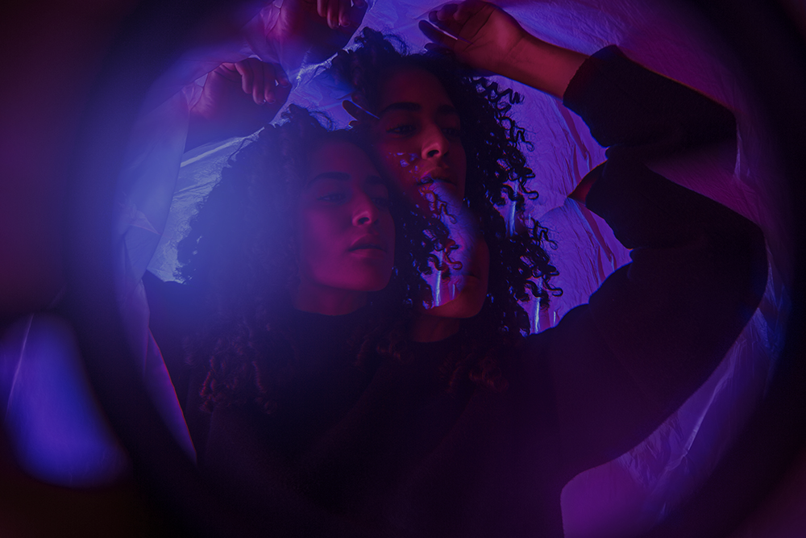
NEON LIGHTS
PRODUCT DEMO
Insert your multimedia content here
Mercury is the closest planet to the Sun and the smallest one in the Solar System

Slide 17

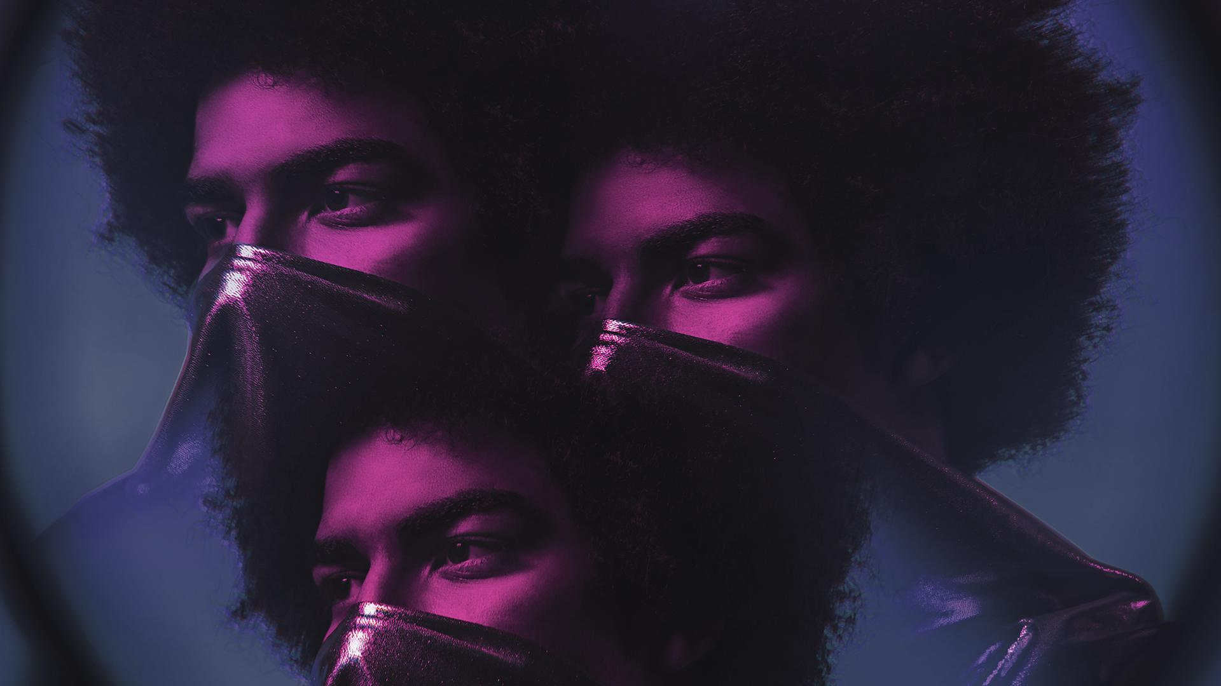
A PICTURE IS WORTH THOUSAND WORDS

Slide 18



“This is a quote, words full of wisdom that someone important said and can make the reader get inspired.”
—SOMEONE FAMOUS

Slide 19
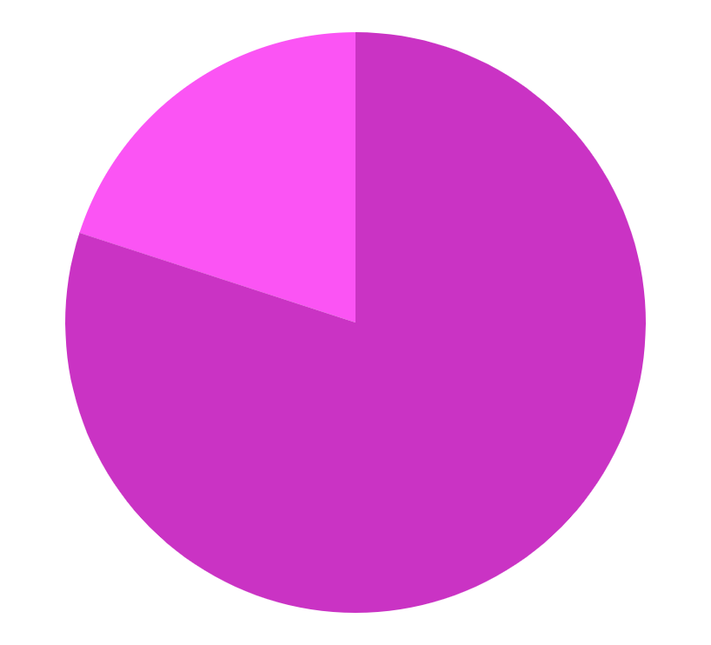

TRACTION
40,000
Despite being red, Mars is actually a cold place
50,000
Jupiter is the biggest planet in the Solar System
To modify this graph, click on it, follow the link, change the data and paste the new graph here

Slide 20


AWESOME WORDS

Slide 21
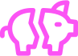



CASE STUDY
CHALLENGE
RESULTS
SOLUTION
Despite being red, Mars is actually a very cold place
Despite its beautiful name, Venus is a terribly hot planet
Jupiter is actually the biggest planet in the Solar System

Slide 22
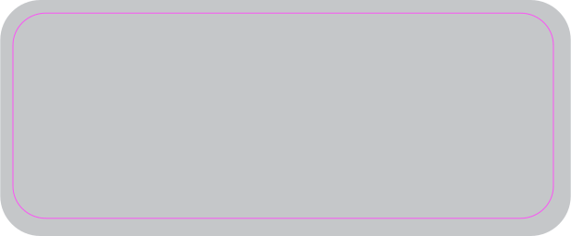
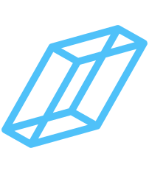
REVIEWS
“Mercury is the closest planet to the Sun”
“Venus has a beautiful name, but it’s hot”
AMAZING ANNE
BLAZING BOB
“Despite being red, Mars is actually cold”
“Saturn is the ringed planet”
CURIOUS CHRIS
DELIRIOUS DEE

Slide 23



AWARDS
MARS
MERCURY
VENUS
Despite being red, Mars is actually a cold place. It’s full of iron oxide dust
Mercury is the closest planet to the Sun and the smallest in the Solar System
Venus has a beautiful name and is the second closest planet from the Sun

Slide 24

7,498,300
Big numbers catch your audience’s attention

Slide 25
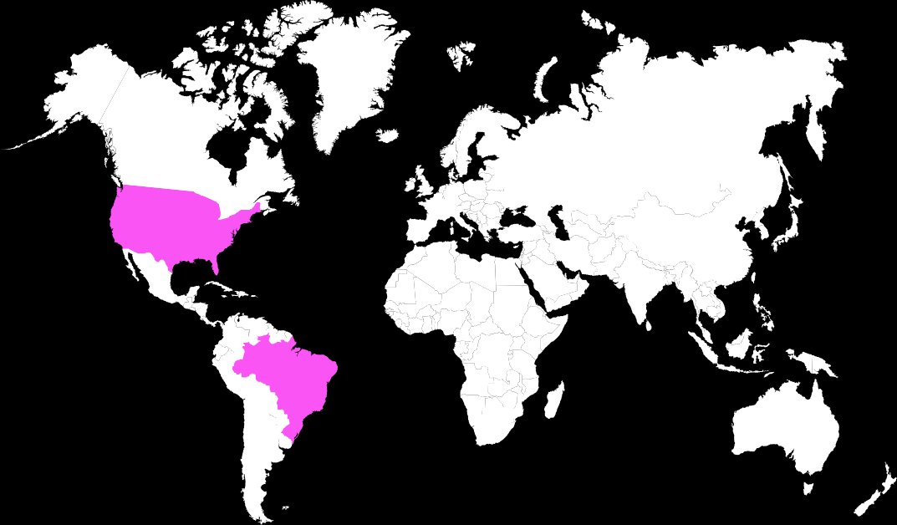
THIS IS A MAP
MERCURY
Mercury is the closest planet to the Sun and the smallest one in the Solar System—it’s only a bit larger than the Moon

Slide 26
SATURN
Saturn is a gas giant and has several rings
MARKET SIZE
55%
MERCURY
5%
Mercury is the closest planet to the Sun
40%
JUPITER
It’s the biggest planet in the Solar System

Slide 27
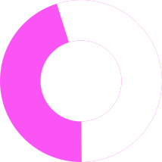
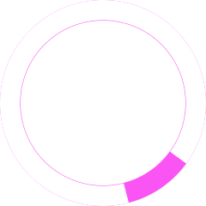
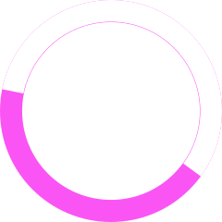


TARGET
GENDER
45%
55%
AGE
25+
24-
Men
Women
INTEREST

Slide 28
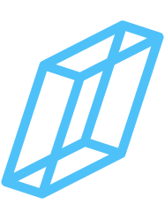







COMPETITORS
VENUS
MERCURY
Venus has a beautiful name, but it’s terribly hot
Mercury is the smallest closest planet to the Sun
MARS
JUPITER
Despite being red, Mars is actually a cold place
Jupiter is the biggest planet in the Solar System

Slide 29

BUSINESS MODEL
VENUS
MERCURY
Venus has a beautiful name, but it’s hot
Mercury is the closest planet to the Sun
MARS
JUPITER
Despite being red, Mars is actually cold
It’s the biggest planet in the Solar System

Slide 30
TIMING
Mars is actually a really cold place
Venus has a very beautiful name
Jupiter is the biggest planet of all
DAY 1
DAY 3
DAY 5
DAY 2
DAY 4
Mercury is the closest to the Sun
Neptune is the eighth planet

Slide 31
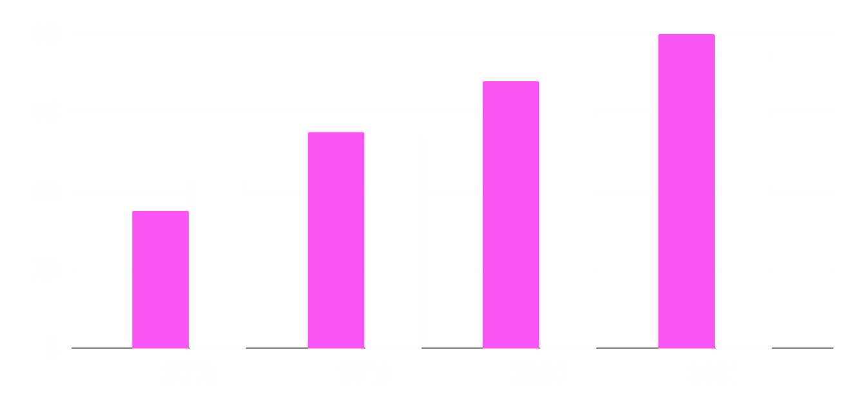
PREDICTED GROWTH
2018
Despite being red, Mars is actually a cold place
2021
Jupiter is the biggest planet in the Solar System
To modify this graph, click on it, follow the link, change the data and paste the new graph here

Slide 32

INVESTMENT
MARS
JUPITER
Despite being red, Mars is actually a cold place
Jupiter is the biggest planet in the Solar System
60%
37%
Mercury is the closest planet to the Sun and the smallest one in the Solar System

Slide 33

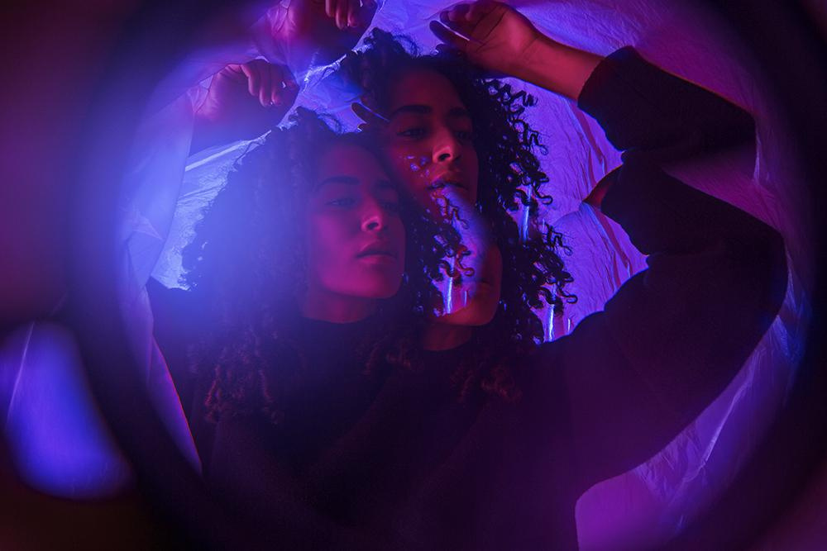

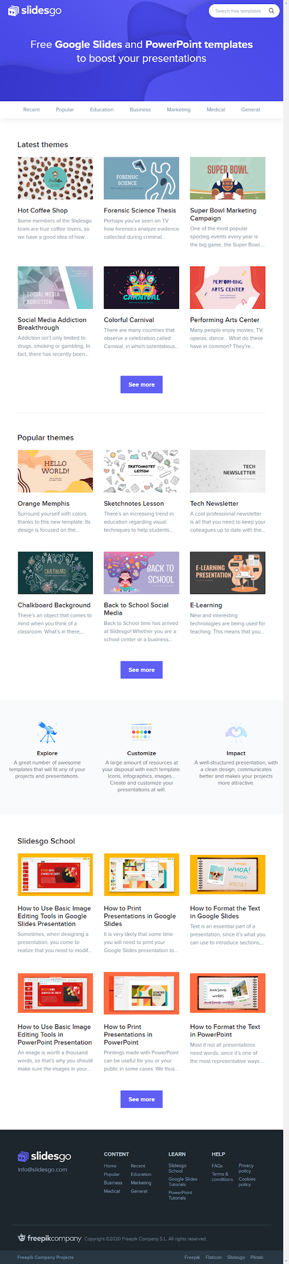
DESKTOP AND TABLET
You can replace the image on these screens with your own work. Just delete these images, then add yours and center them properly

Slide 34
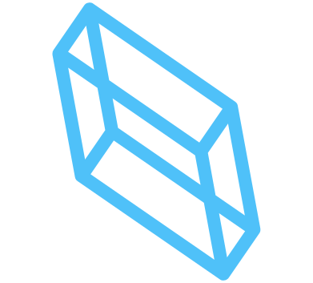




THANKS !
Do you have any questions?
youremail@freepik.com
+91 620 421 838
yourcompany.com
CREDITS: This presentation template was created by Slidesgo, including icons by Flaticon, and infographics & images by Freepik.
Please keep this slide for attribution.

Slide 35

ECONOMY ICON PACK

Slide 36





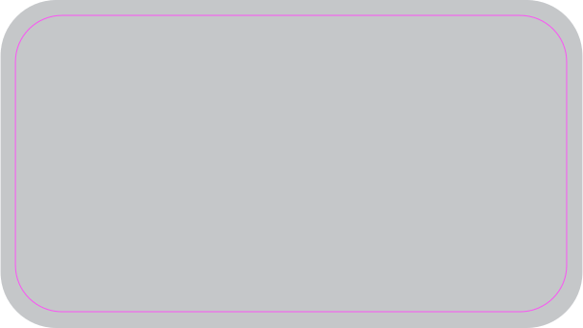
ALTERNATIVE RESOURCES

Slide 37
ALTERNATIVE RESOURCES
Here’s an assortment of alternatives pictures within the same style with this template
VECTORS
Variety of neon light signs
Geometric shapes neon lights background
Background with abstract neon shapes
PHOTOS
Front view couple with plastic foil
Front view couple with water effect lights
Going out concept with girl at night

Slide 38
RESOURCES
Did you like the resources on this template? Get them for free at our other websites.
PHOTOS
Couple back to back with eyes closed
Sideways woman with plastic foil
Portrait of a woman with kaleidoscope effect
Portrait of a man with kaleidoscope effect
VECTORS
Geometric shapes neon lights background
ICONS
Economy Icon Pack

Slide 39
Instructions for use
In order to use this template, you must credit Slidesgo by keeping the Thanks slide.
You are allowed to:
- Modify this template.
- Use it for both personal and commercial projects.
You are not allowed to:
- Sublicense, sell or rent any of Slidesgo Content (or a modified version of Slidesgo Content).
- Distribute Slidesgo Content unless it has been expressly authorized by Slidesgo.
- Include Slidesgo Content in an online or offline database or file.
- Offer Slidesgo templates (or modified versions of Slidesgo templates) for download.
- Acquire the copyright of Slidesgo Content.
For more information about editing slides, please read our FAQs or visit Slidesgo School:
https://slidesgo.com/faqs and https://slidesgo.com/slidesgo-school

Slide 40
Fonts & colors used
This presentation has been made using the following fonts:
Orbitron
(https://fonts.google.com/specimen/Orbitron)
IBM Plex Sans
(https://fonts.google.com/specimen/IBM+Plex+Sans)
#fda7f9
#fb54f4
#4fc1f9
#5f3f9e

Slide 41

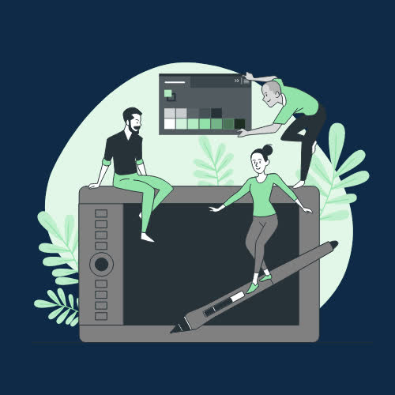

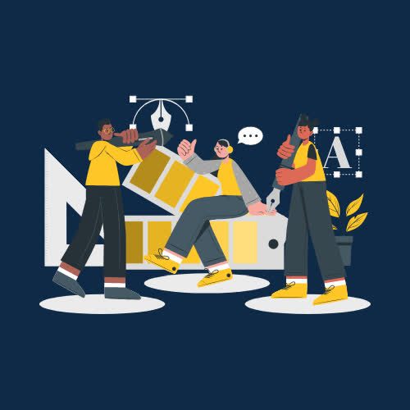

Stories by Freepik
Create your Story with our illustrated concepts. Choose the style you like the most, edit its colors, pick the background and layers you want to show and bring them to life with the animator panel! It will boost your presentation. Check out How it Works.
Pana
Amico
Bro
Rafiki
Cuate

Slide 42

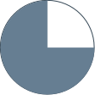



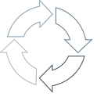


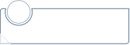
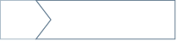

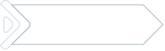

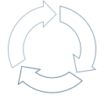
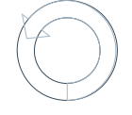





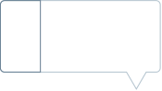
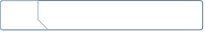

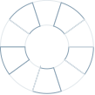

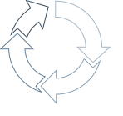

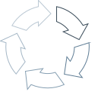


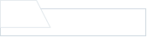

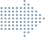

Use our editable graphic resources...
You can easily resize these resources without losing quality. To change the color, just ungroup the resource and click on the object you want to change. Then, click on the paint bucket and select the color you want. Group the resource again when you’re done. You can also look for more infographics on Slidesgo.

Slide 43





















Slide 44














Slide 45




JANUARY
FEBRUARY
MARCH
APRIL
MAY
JUNE
PHASE 1
Task 1
Task 2
PHASE 2
Task 1
Task 2
JANUARY
FEBRUARY
MARCH
APRIL
PHASE 1
Task 1
Task 2

Slide 46

































Slide 47




















Slide 48
























































































...and our sets of editable icons
You can resize these icons without losing quality.
You can change the stroke and fill color; just select the icon and click on the paint bucket/pen.
In Google Slides, you can also use Flaticon’s extension, allowing you to customize and add even more icons.

Slide 49




































































































Educational Icons
Medical Icons

Slide 50




































































































Business Icons
Teamwork Icons

Slide 51




































































































Help & Support Icons
Avatar Icons

Slide 52


























































































Creative Process Icons
Performing Arts Icons

Slide 53


















































Nature Icons

Slide 54

































































SEO & Marketing Icons

Slide 55


